Slide 1
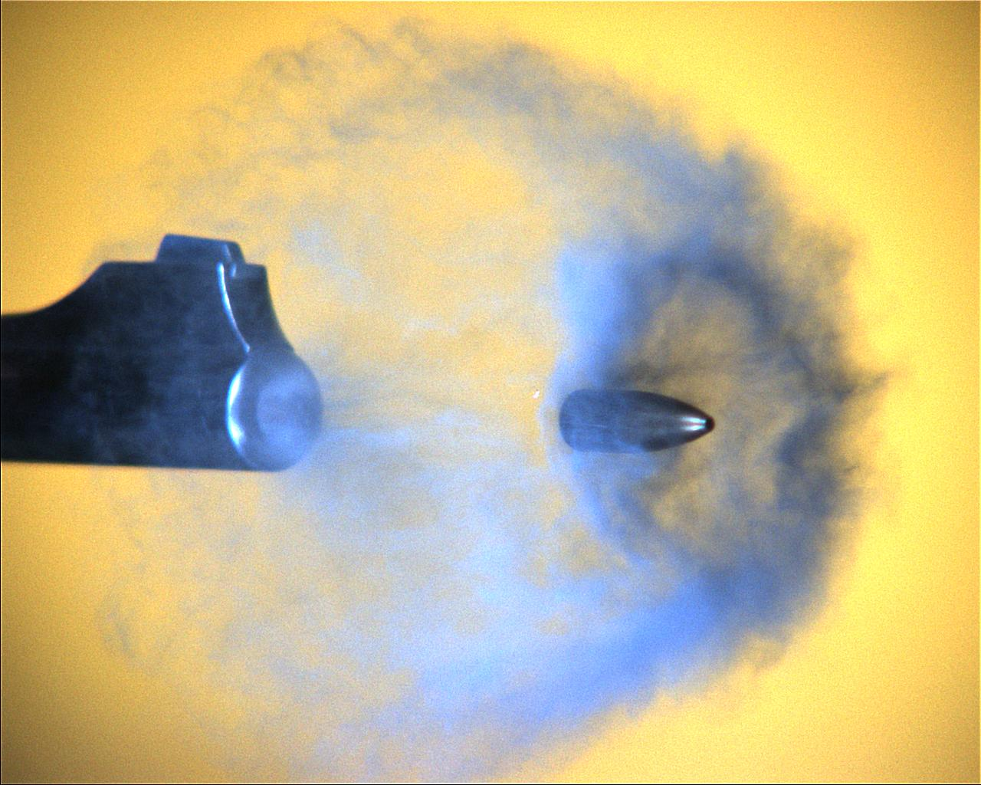
FORENSIC BALLISTICS
DR. SALINI CHANDRAN HOD; DEPT: OF FORENSIC MEDICINE & TOXICOLOGY

Slide 2
FORENSIC BALLISTICS
Science dealing with the investigation of firearms,ammunition and problems arising from their use

Slide 3
What is a firearm?

Slide 4
In law, a firearm is defined as "a lethal barrelled weapon of any description from which any shot, bullet or missile can be discharged".
a better definition is that a firearm is an object with a barrel, through which a projectile or shot is discharged through the action of expanding gases from the burning of an explosive, or through the action of compressed air or gas which expands

Slide 5
CLASSIFICATION

Slide 6
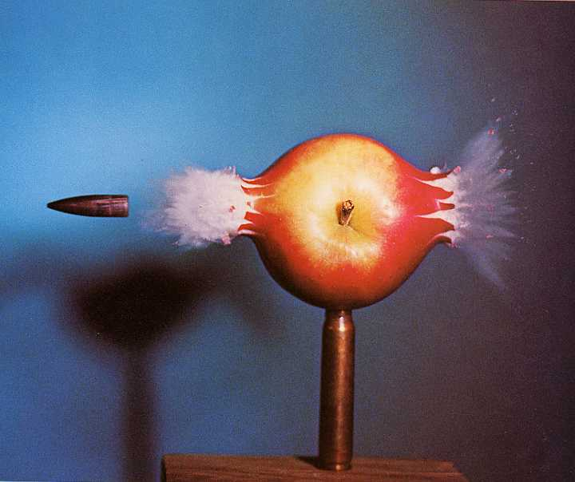
CLASSIFICATION
I.Rifled Weapons
II. Smooth bored weapons

Slide 7
Rifled Weapons
1.Rifles a)Air & gas operated rifles
b)0.22 rifles
c)Military & sporting rifles
2.Single shot target practice pistols
3.Revolvers
4.Automatic pistols
5.True automatic weapons (machine guns)

Slide 8
II.SMOOTH BORED WEAPONS (shotgun)
Single barrel
Double barrel
Over-bolt Action
According to firing action Under-bolt Action
Lever –Action
Pump Action or
Autoloading Model

Slide 9
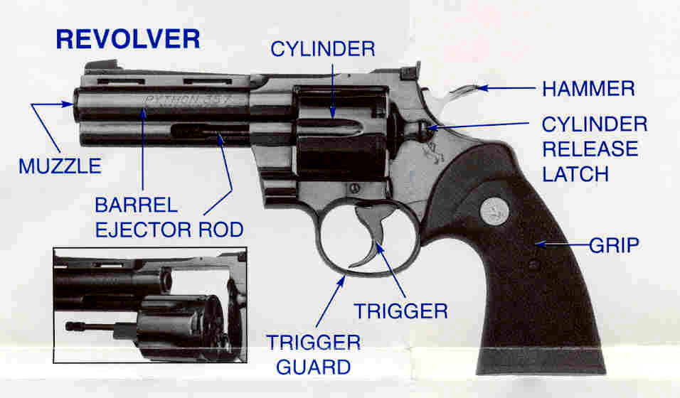
PARTS OF A FIREARM
SIGHT
REAR SIGHT

Slide 10
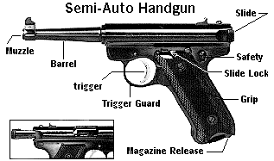

Slide 11
Shotgun: A gun with a smoothbore barrel and is fired from the shoulder using both hands
shoots cartridges that contain "shot" or small metal pellets (of lead or steel) as the projectiles
Shotguns have a much shorter range than most rifles or pistols
Double barrel: Two barrels side by side or one on top of the other, usually on a shotgun.

Slide 12
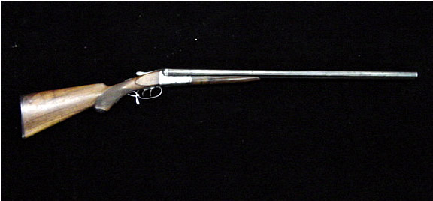
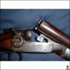
SHOTGUN
M May be single –barrelled ay be single –barrelled or double –barrelled
Shotguns have a similar external appearance to rifles, but differ in the lack of rifling inside the barrel,
A shotgun shell may contain one large projectile (called a slug), a few pellets of large shot, or many tiny pellets.
Barrel length-55-72 cm
Common gauges-12,16,20

Slide 13
"Rifle" - a rifle is a firearm with a stock and a rifled barrel which is fired using both hands and is shoulder-mounted

Slide 14
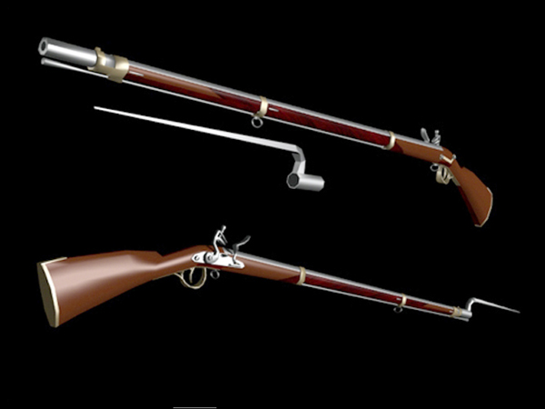
MUSKET
Smooth bored, long barrelled old type military guns with bayonet at the muzzle end

Slide 15
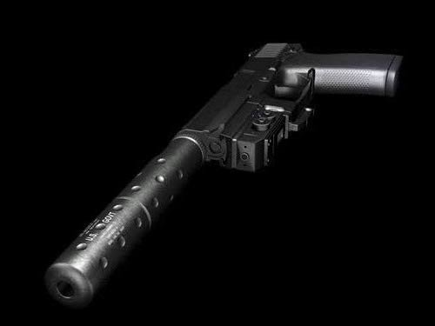
The weapon is made to break open on hinge across the breech facing for insertion and extraction of cartridge cases
Muzzle loading-loaded from muzzle
Lack rifling inside the barrel
Cylinder bore- diameter when same throughout
Choke bore-distal 7-10 cm is narrow
different degrees-full choke ,three quarter choke,half choke ,quarter choke,etc

Slide 16
Degree of choking | Degree of constriction
Full choke | 40/1000th of an inch
Three quarter choke | 30/1000th of an inch
Half choke | 20/1000th of an inch
Quarter choke | 10/1000th of an inch
Improved cylinders | 3-5/1000th of an inch

Slide 17
PARADOX GUNS
Smooth-Bored guns in which the inner surface of the barrel near the muzzle is grooved like rifles

Slide 18
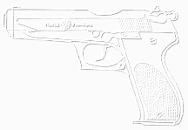
"Rifle" - a rifle is a firearm with a stock and a rifled barrel which is fired using both hands and is shoulder-mounted
Shotgun: A gun with a smoothbore that shoots cartridges that contain "shot" or small metal pellets (of lead or steel) as the projectiles
Revolver: Handgun that has a cylinder with holes to contain the cartridges. The cylinder revolves to bring the cartridge into position to be fired.
This is "single-action" when the hammer must be cocked before the trigger can fire the weapon.
It is "double-action" when pulling the trigger both cocks and fires the gun.

Slide 19
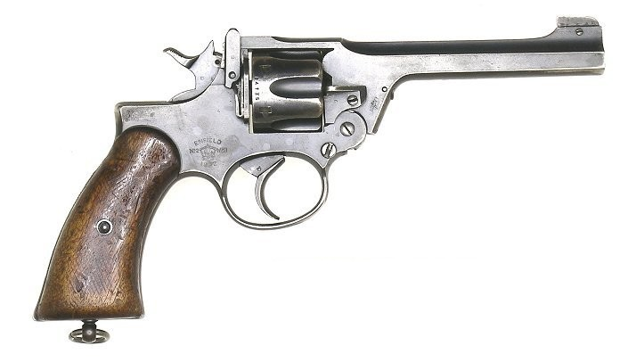
Revolver

Slide 20
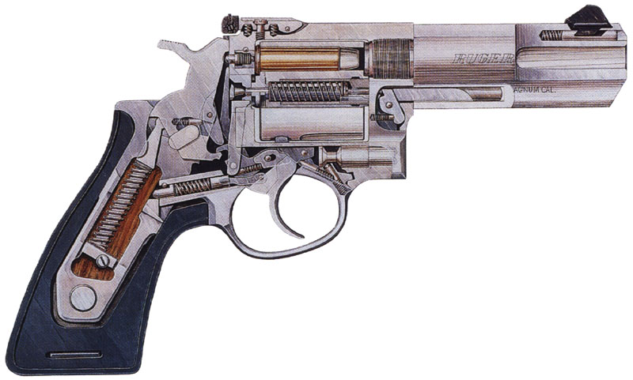
Revolver

Slide 21
Machineguns"
"Machineguns" - this covers firearms such as assault rifles, submachine guns etc.
A machinegun is a firearm capable of firing successive shots with a single pull on the trigger

Slide 22
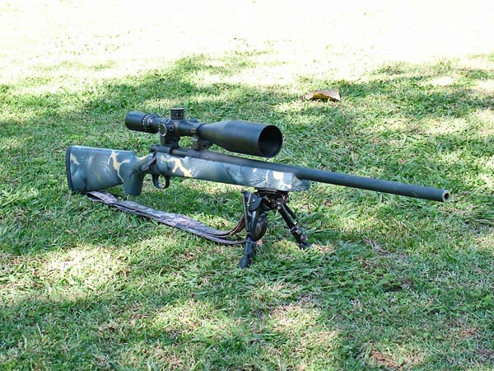
Assault rifle

Slide 23
"Handgun"
which includes a pistol, revolver, air pistol, muzzle-loading pistol, etc.
This is a firearm without a shoulder stock which is held and fired from a person's hand or hands, and is typically smaller than other types of firearm.
Also, most handguns have rifled barrels
Pistol: Synonym for a handgun that does not have a revolving cylinder.

Slide 24
Butt or buttstock: The portion of the gun which is held or shouldered
Barrel: The metal tube through which the bullet is fired.
Chamber: The portion of the "action" that holds the cartridge ready for firing.
Bore: The inside of the barrel. "Smoothbore" weapons (typically shotguns) have no rifling. Most handguns and rifles have "rifling".
Breech: The end of the barrel attached to the action.
Magazine: This is a device for storing cartridges in a repeating firearm for loading into the chamber. Also referred to as a "clip"
Barrel: The metal tube through which the bullet is fired.

Slide 25
Stock: A wood, metal, or plastic frame that holds the barrel and action and allows the gun to be held firmly.
Hammer: A metal rod or plate that strikes the cartridge primer to detonate the powder.
Muzzle: The end of the barrel out of which the bullet comes.
Choke: A constriction of a shotgun bore at the muzzle that determines the pattern of the fired shot

Slide 26
Safety: A mechanism on an action to prevent firing of the gun.
Cartridge: Also called a "round". Made up of a case, primer, powder, and bullet.

Slide 27
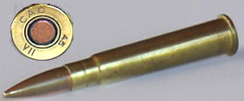
Cartridge
Cartridge or round packages the bullet
, gunpowder and primer into a single metallic case
precisely made to fit the firing chamber of a firearm
The primer is a small charge of impact-sensitive chemical that may be located at the center of the case head (centerfire ammunition) or at its rim (rimfire ammunition).
Rimmed, centerfire .303 in
cartridge from WWII.

Slide 28
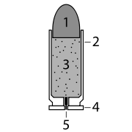
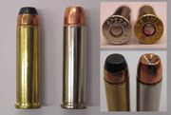
Cartridge
1.the bullet itself
2. the casing, which holds all parts together
3. the explosive, for example
gunpowder
4. the rim, at the base of the cartridge
5. the primer, which ignites the gunpowder

Slide 29
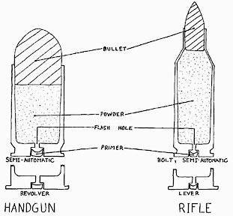

Slide 30
Gauge: Refers to the diameter of the barrel on a shotgun in terms of the number of lead balls the size of the bore it would take to weigh one pound (454 gm) (10 gauge, 12 gauge, etc.)
Caliber: The diameter of the bore measured from land to land, usually expressed in hundredths of an inch (.22 cal) or in millimeters (9mm).

Slide 31
M
A
T
E
R
I
A
L
Lead: Simple cast, extruded, swaged, or otherwise fabricated lead slugs are the simplest form of bullets
Jacketed Lead: Bullets intended for high-velocity applications generally have a lead core jacketed or plated with copper or steel; the thin layer of copper protects the lead core during flight, delivering it intact to the target.
Armor Piercing: Jacketed designs where the core material is a very hard and high-density metal such as tungsten, tungsten carbide, depleted uranium, or steel.

Slide 32
Ignition: The way in which powder is ignited. Old muzzle-loading weapons used flintlock or percussion caps. Modern guns use "primers" that are "rimfire" or "centerfire“
Centerfire: The cartridge contains the primer in the center of the base, where it can be struck by the firing pin of the action.
"Rimfire" cartridges have primer inside the base,
while "centerfire" cartridges have primer in a hole in the middle of the base of the cartridge case.

Slide 33
Magnum: An improved version of a standard cartridge which uses the same caliber and bullet, but has more powder, giving the fired bullet more energy. Magnum shotgun loads, however, refer to an increased amount of shot pellets in the shell.
Silencer: A device that fits over the muzzle of the barrel to muffle the sound of a gunshot.
Most work by baffling the escape of gases.

Slide 34
Powder: Modern gun cartridges use "smokeless" powder that is relatively stable, of uniform quality, and leaves little residue when ignited.
Black Powder: The old form of gunpowder invented over a thousand years ago and consisting of nitrate, charcoal, and sulfur.
For centuries, "black powder" was used and was quite volatile (ignited at low temperature or shock), was composed of irregularly sized grains, and left a heavy residue after ignition, requiring frequent cleaning of bore

Slide 35
Primer: A volatile substance that ignites when struck to detonate the powder in a cartridge.
Smokeless powder: Refers to modern gunpowder, which is really not "powder" but flakes of nitrocellulose and other substances. Not really "smokeless" but much less so than black powder.

Slide 36
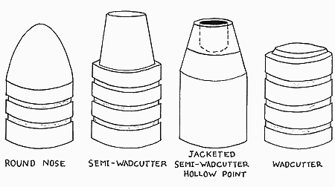
Bullets:

Slide 37
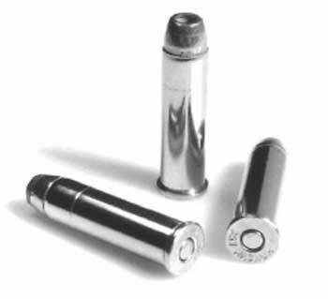
Incendiary: These bullets are made with an explosive or flammable mixture in the tip which is designed to ignite on contact with a target. The intent is to ignite fuel in the target area and add to the destructive power of the bullet itself.
Tracer: These have a hollow
back, filled with a flare material
Usually this is a mixture of
magnesium, perchlorate,
and chromium,
to yield a bright red color

Slide 38
Frangible: Designed to disintegrate into tiny particles upon impact to minimize their penetration for reasons of range safety, to limit environmental impact, or to limit the danger behind the intended target

Slide 39
"round-nose" - The end of the bullet is blunted.
"hollow-point" - There is a hole in the bullet that creates expansion when a target is struck, creating more damage.
"jacketed" - The soft lead is surrounded by another metal, usually copper, that allows the bullet to penetrate a target more easily.
"wadcutter" - The front of the bullet is flattened.
"semi-wadcutter" - Intermediate between round-nose and wadcutter.
"semi-wadcutter" - Features of both semi-wadcutter and hollowpoint.

Slide 40
"Handgun"
which includes a pistol, revolver, air pistol, muzzle-loading pistol, etc
This is a firearm without a shoulder stock which is held and fired from a person's hand or hands, and is typically smaller than other types of firearm.
Also, most handguns have rifled barrels

Slide 41
BALLISTICS
The term ballistics refers to the science of the travel of a projectile in flight.
The flight path of a bullet includes: travel down the barrel, path through the air, and path through a target.

Slide 42
The cartridge seals a firing chamber in all directions except down the bore.
A firing pin strikes the primer, igniting it. The spark from the primer ignites the powder.
Burning gases from the powder expand the case to seal against the chamber wall.
The projectile is then pushed in the direction that releases this pressure, down the barrel.
After the projectile leaves the barrel the pressure is released and the cartridge case is pulled out of the chamber.

